Slide 1
Energy Resources
Chapter
6
Learning outcomes: 1.9, 2.2

Slide 2
At the end of this chapter, you will be able to:
6.1 Describe the different renewable and non-renewable energy resources.
6.2 Describe and explain the environmental, economic and social consequences of exploiting energy resources.
6.3 Explain the need to use energy resources sustainably.

Slide 3
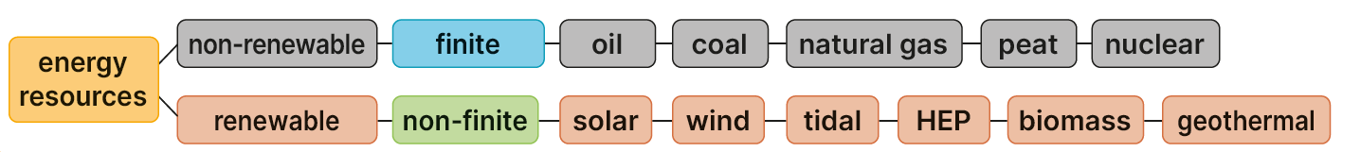
Keyword connections

Slide 4
6.1 Describe the different renewable and non-renewable energy resources.
Energy resources are sources of fuel for human activities.
Used to provide light, heat and power at home, in industry and in transport
Energy resources can be either renewable or non-renewable.
Renewable resources
Renewable energy resources are resources that can be used over and over again.
They are non-finite, which means they do not run out.
Non-renewable resources
Non-renewable energy resources are resources that cannot be replaced once they are used up.
They are finite, which means they will eventually run out. Non-renewable energy resources include oil, peat and coal.

Slide 5
6.1 Describe the different renewable and non-renewable energy resources.
Go to Section 6.1 on page 21 of your Skills Book.
Complete Questions 1 and 2.

Slide 6
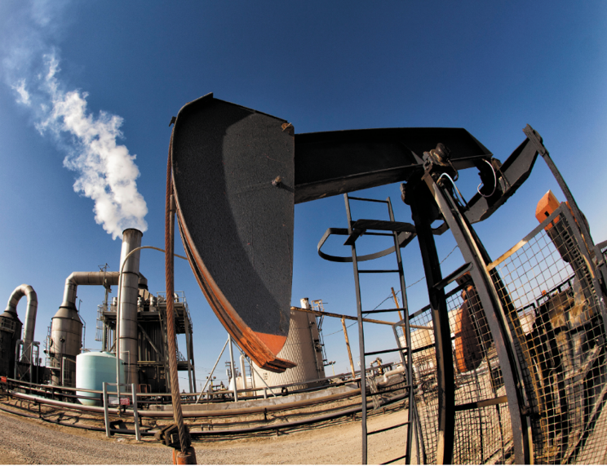
6.1 Describe the different renewable and non-renewable energy resources.
Non-renewable energy sources
Oil
Location: Persian Gulf, Middle East; USA; Russia
Extraction: drilling
Uses: heating homes; industry; by-products, e.g. petrol, paints, plastics
Advantages: cheap; burns more cleanly than coal; easily available and transported; efficient, gives off a lot of energy
Disadvantages: oil spills damaging to environment; price fluctuates

Slide 7
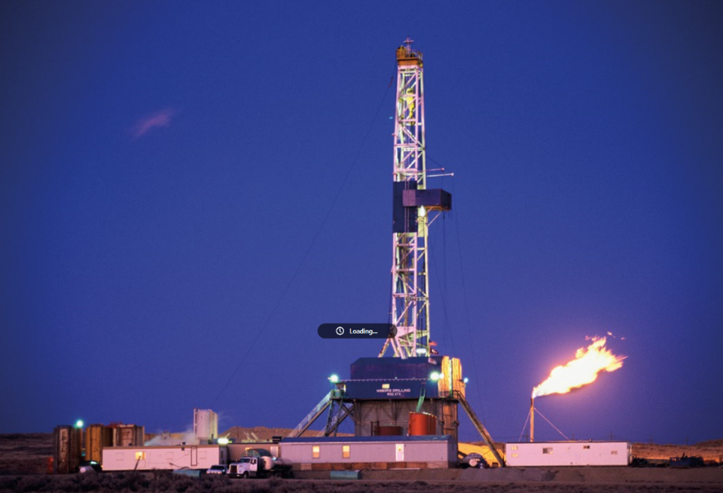
6.1 Describe the different renewable and non-renewable energy resources.
Non-renewable energy sources
Natural gas
Location: Ireland
Extraction: drilling
Uses: heating homes
Advantages: cheap; easily available; sourced in Ireland
Disadvantages: finite; emits CO₂

Slide 8
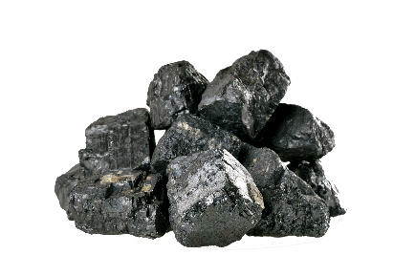
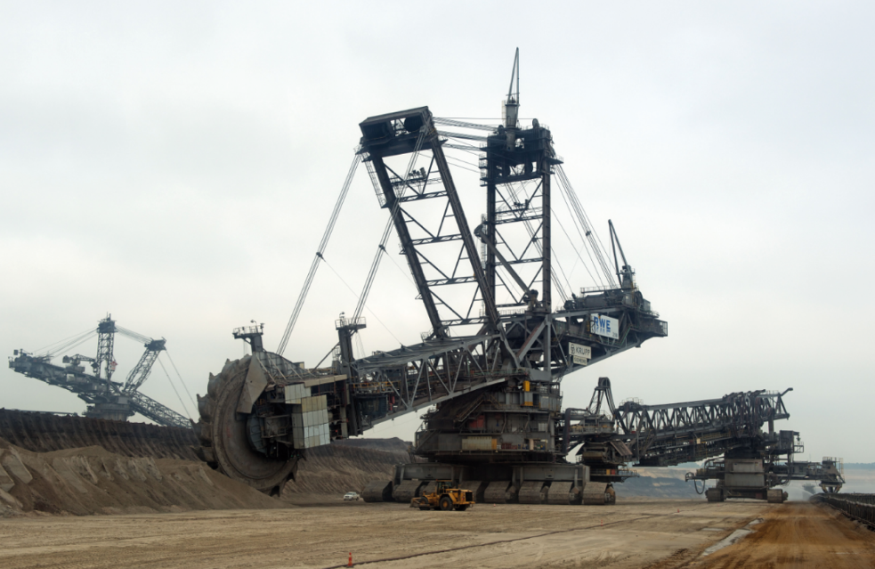
6.1 Describe the different renewable and non-renewable energy resources.
Non-renewable energy sources
Coal
Location: Poland
Extraction: open cast mining
Uses: heating homes
Advantages: cheap; easily available
Disadvantages: finite; emits CO₂

Slide 9
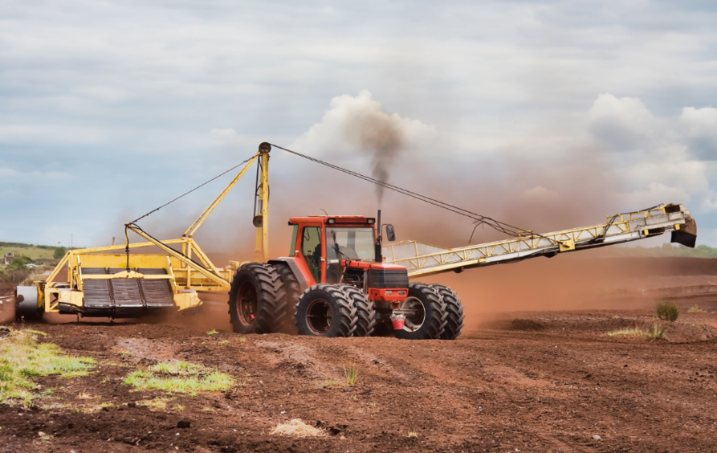
6.1 Describe the different renewable and non-renewable energy resources.
Non-renewable energy sources
Peat
Location: raised bogs, Midlands Ireland
Extraction: machinery
Uses: heating homes, briquettes; power stations owned by Bord na Móna; moss peat used in gardens
Advantages: cheap; easily available; sourced in Ireland
Disadvantages: finite; emits CO₂

Slide 10
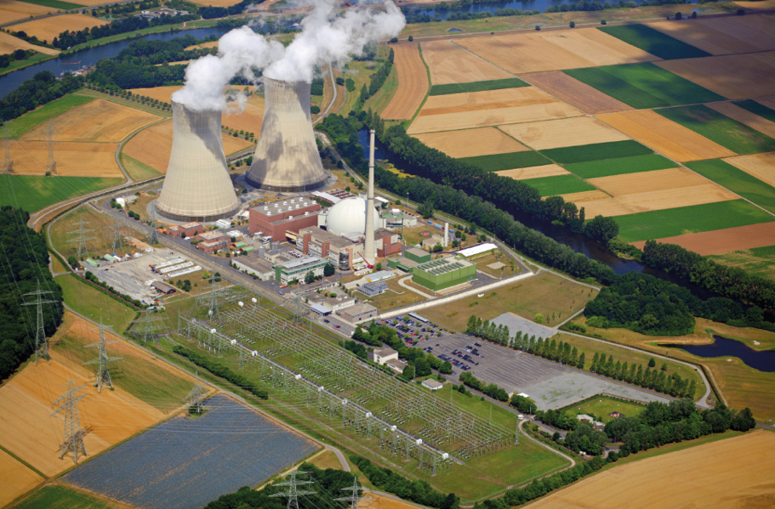
6.1 Describe the different renewable and non-renewable energy resources.
Non-renewable energy sources
Nuclear energy
Location: England; France
Uses: not in use in Ireland; Europe – for industrial use
Disadvantages: finite; emits CO₂; unstable and can have a disastrous effect on all living things; costly to store safely

Slide 11

6.1 Describe the different renewable and non-renewable energy resources.
1. What is a non-renewable energy resource?
2. What is meant by the term ‘non-finite’?
3. Why is oil a popular energy resource?
4. Suggest one reason to stop using coal.
5. Suggest a reason why Ireland has no nuclear power stations.

Slide 12
6.1 Describe the different renewable and non-renewable energy resources.
Higher-order questions 1
1. If oil was discovered off the coast of Ireland, should we extract it?
2. Should Ireland build a nuclear power plant to meet our electricity needs?
3. Read up on the Industrial Revolution in your History book. Why was coal so important then? What was the effect of this?

Slide 13
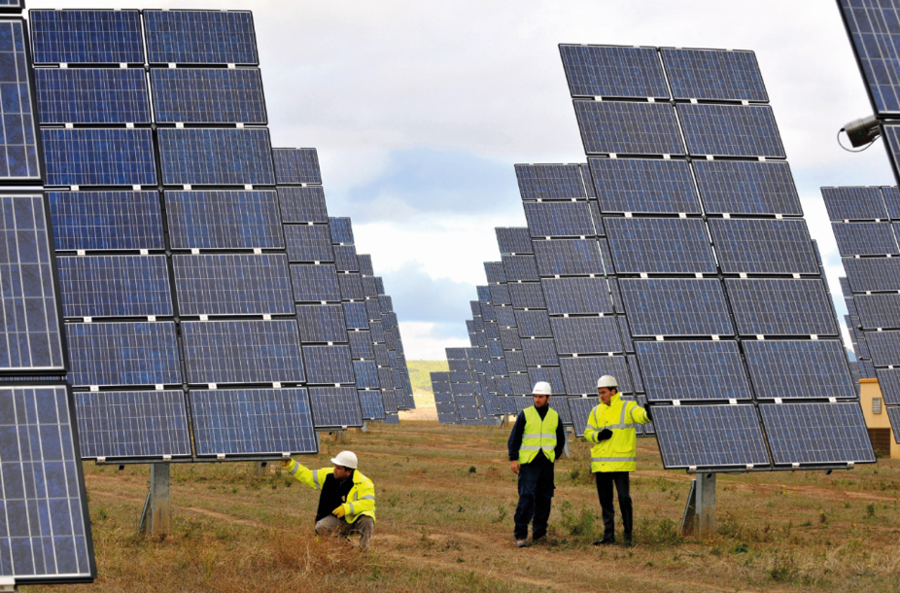
6.1 Describe the different renewable and non-renewable energy resources.
Renewable energy sources
Solar energy
Location: all locations
Extraction: solar panels
Uses: heating individual homes; powering road signs
Advantages: clean, as it has no CO₂ emissions; free except for start-up costs; non-finite
Disadvantages: amount of energy changes throughout the year

Slide 14
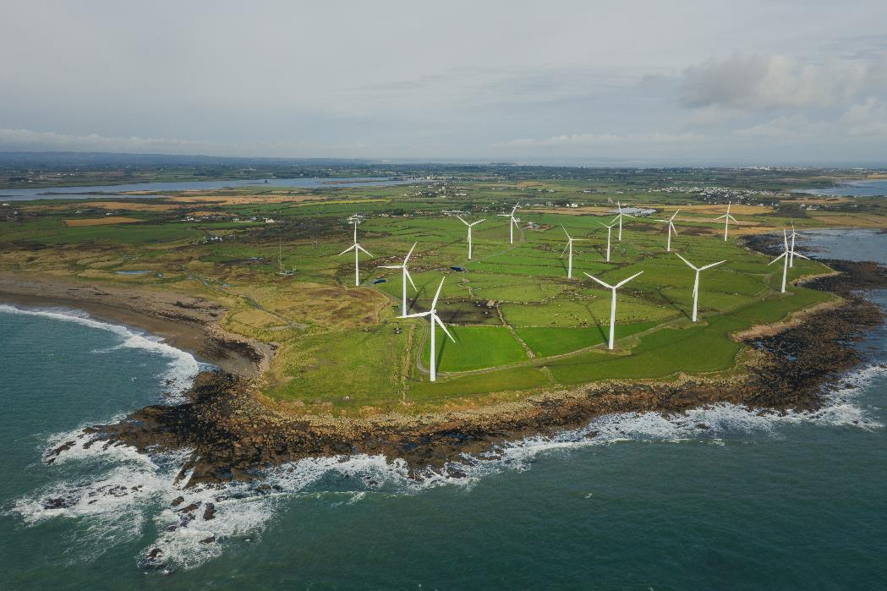
6.1 Describe the different renewable and non-renewable energy resources.
Renewable energy sources
Wind energy
Location: coastal areas
Extraction: turbines
Uses: added to the National Grid supply
Advantages: clean, as it has no CO₂ emissions; non-finite
Disadvantages: turbines are often placed in areas of natural beauty
Image: 4H4 Photography/Shutterstock.com

Slide 15
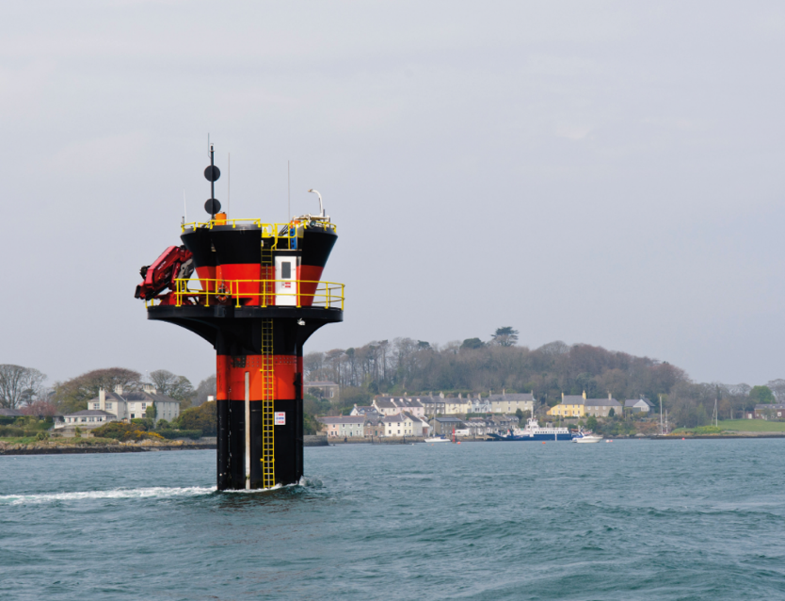
6.1 Describe the different renewable and non-renewable energy resources.
Renewable energy sources
Tidal energy
Location: coastal areas
Extraction: underwater turbines
Uses: potential being researched at present
Advantages: clean, as it has no CO₂ emissions; non-finite
Disadvantages: turbines are often placed in areas of natural beauty and can look unsightly

Slide 16
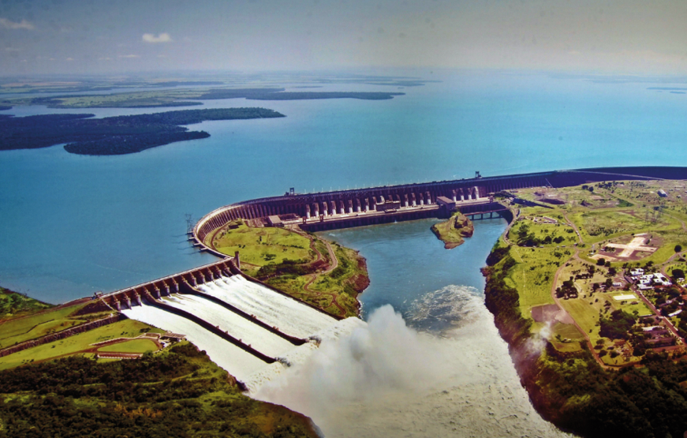
6.1 Describe the different renewable and non-renewable energy resources.
Renewable energy sources
HEP
Location: steep slopes with rivers
Extraction: dams
Uses: added to the National Grid supply
Advantages: clean, as it has no CO₂ emissions; reservoir lakes are recreational areas; non-finite
Disadvantages: disrupts the natural cycle of fish life in the river; lakes are created behind the dam, flooding farmland and homes

Slide 17
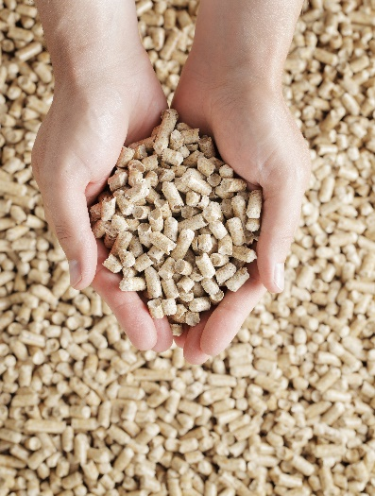
6.1 Describe the different renewable and non-renewable energy resources.
Renewable energy sources
Biomass
Location: upland areas
Extraction: harvested
Uses: heating homes; some used to produce biofuels for transport
Advantages: non-finite
Disadvantages: uses land that could grow food; requires changes to heaters and engines to use

Slide 18
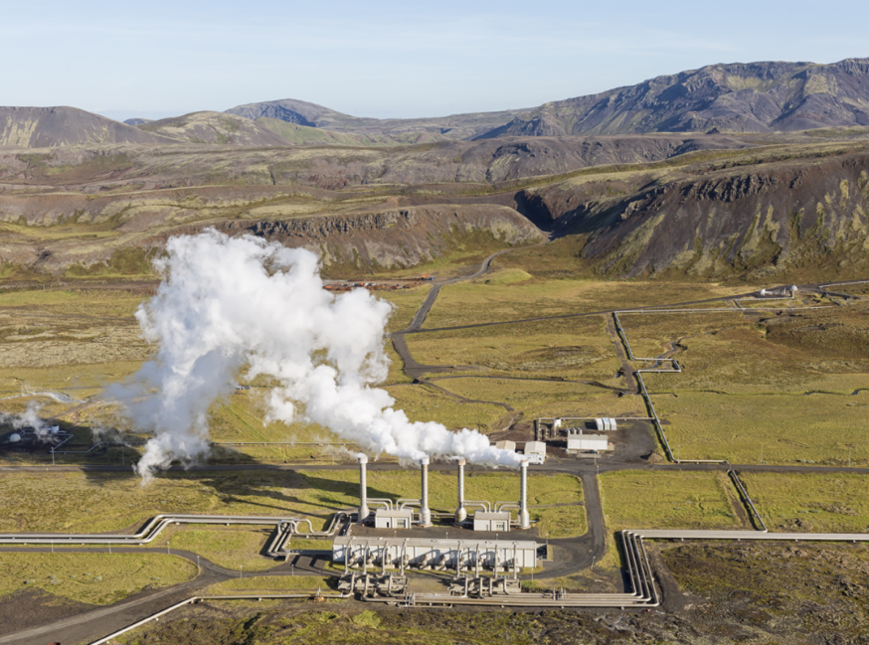
6.1 Describe the different renewable and non-renewable energy resources.
Renewable energy sources
Geothermal
Location: all locations
Extraction: underground pipe system
Uses: heating homes
Advantages: clean as it has no CO₂ emissions; non-finite
Disadvantages: Ireland’s ground temperature is not warm enough to make this successful on a large scale

Slide 19

6.1 Describe the different renewable and non-renewable energy resources.
1. What is a renewable energy resource?
2. What is a wind farm?
3. What does ‘HEP’ mean?
4. What is a key disadvantage of biomass?
5. What is a solar panel?

Slide 20
6.1 Describe the different renewable and non-renewable energy resources.
Higher-order questions 2
1. Should we build wind farms in as many upland locations as possible?
2. Is biomass really a renewable energy source?
3. Does Ireland have any geothermal energy? Do an internet search and report what you find.

Slide 21
6.1 Describe the different renewable and non-renewable energy resources.
Go to Section 6.1 on page 22 of your Skills Book.
Complete Question 3.

Slide 22
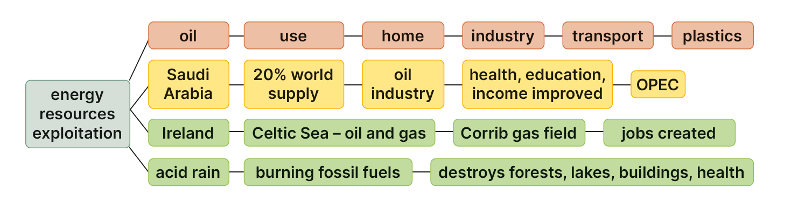
6.2 Describe and explain the environmental, economic and social consequences of exploiting energy resources.
Keyword connections

Slide 23
6.2 Describe and explain the environmental, economic and social consequences of exploiting energy resources.
Impact of exploitation: Oil
1. Domestic use: oil is used to generate electricity and to heat homes.
2. Industrial use: oil generates electricity and powers industrial machines.
3. Transport fuel: oil is used to power cars and other vehicles.
4. Material use: oil is the raw material for plastics, including artificial fibres.
Activity
Look at all the things you used or carried with you today.
Make a list of all the items that contain plastic. How may can you identify?

Slide 24

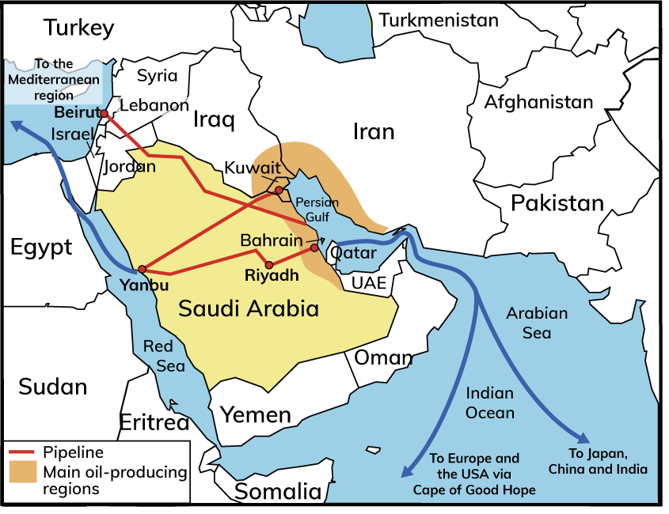
6.2 Describe and explain the environmental, economic and social consequences of exploiting energy resources.
Impacts of Oil Exploitation: Saudi Arabia
Saudi Arabia
1. Located in the Middle East
2. Mostly desert
3. Was a poor country:
Inhabited by Bedouin nomads, who herded camels and goats
4. Oil discovered in 1930s:
Development of oil-based industries

Slide 25
6.2 Describe and explain the environmental, economic and social consequences of exploiting energy resources.
Impacts of Oil Exploitation on Saudi Arabia
Environmental impacts
Positive impacts | Negative impacts
Oil is an efficient fuel that does not emit a lot of smoke. Compared to other fossil fuels, it gives off a lot of energy when burned. | Oil spills can kill fish, birds and animals. It emits harmful greenhouse gases, (e.g. carbon dioxide) and aids the formation of acid rain.

Slide 26
6.2 Describe and explain the environmental, economic and social consequences of exploiting energy resources.
Impacts of Oil Exploitation on Saudi Arabia
Economic impacts
Positive impacts | Negative impacts
Brought huge wealth to Saudi Arabia. Responsible for massive job creation in other sectors of Saudi Arabia and globally. Oil wealth has helped develop other sectors of the economy. | Finite resource that will run out in 100 years. Non-nationals attracted by available jobs. As income from oil decreases, many of these non-nationals may lose their jobs.

Slide 27
6.2 Describe and explain the environmental, economic and social consequences of exploiting energy resources.
Impacts of Oil Exploitation on Saudi Arabia
Social impacts
Positive impacts | Negative impacts
People in Saudi Arabia enjoy a high standard of living. The country has excellent health, education and infrastructural services. Demand for workers in the oil industry has led to inward migration. | As the job market shrinks, non-nationals will lose jobs. Increasing oil wealth has led to a gap between those with wealth and those without.

Slide 28
6.2 Describe and explain the environmental, economic and social consequences of exploiting energy resources.
OPEC
Organization of the Petroleum Exporting Countries (14 countries)
OPEC controls how much oil is produced.
This means it can control the price people pay for petrol.
In 1973, OPEC drastically reduced oil production.
The price of oil rose from $3 per barrel to $12, and then to $40 per barrel by 1979.
Huge effect on businesses
Transport costs increased.
By the 1980s, the world was experiencing a recession.
Companies cut costs and reduced the number of workers they hired.
The effects of this recession lasted until the 1990s.

Slide 29
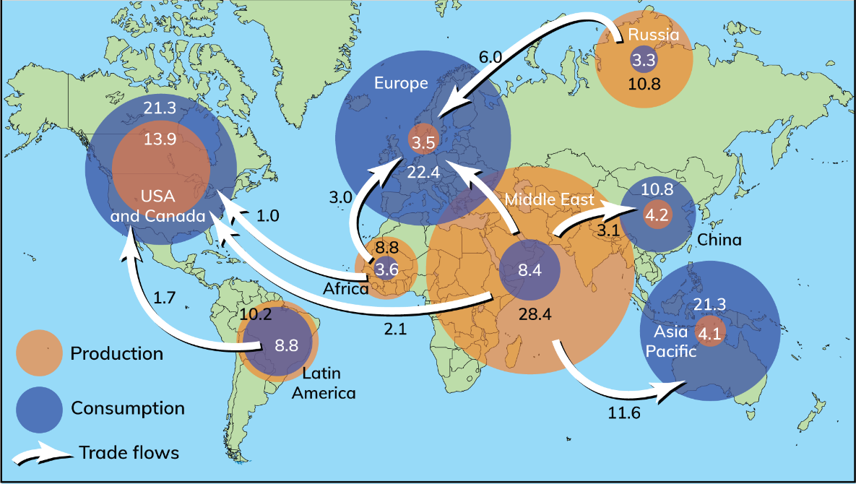
6.2 Describe and explain the environmental, economic and social consequences of exploiting energy resources.

Slide 30


6.2 Describe and explain the environmental, economic and social consequences of exploiting energy resources.
1. Summarise four uses of oil.
2. What changes did the discovery of oil bring to Saudi Arabia’s economy?
3. Which region of the world produces the most oil?
4. Which region of the world consumes the most oil?
5. Why do we need to reduce our consumption of oil?

Slide 31
6.2 Describe and explain the environmental, economic and social consequences of exploiting energy resources.
Higher-order questions 3
1. What would happen to Saudi Arabia if people suddenly stopped using oil?
2. What is the impact on Europe of being dependent on oil?
3. Should public transport be free to encourage people to stop using private cars?

Slide 32
6.2 Describe and explain the environmental, economic and social consequences of exploiting energy resources.
Go to Section 6.2 on page 23 of your Skills Book.

Slide 33

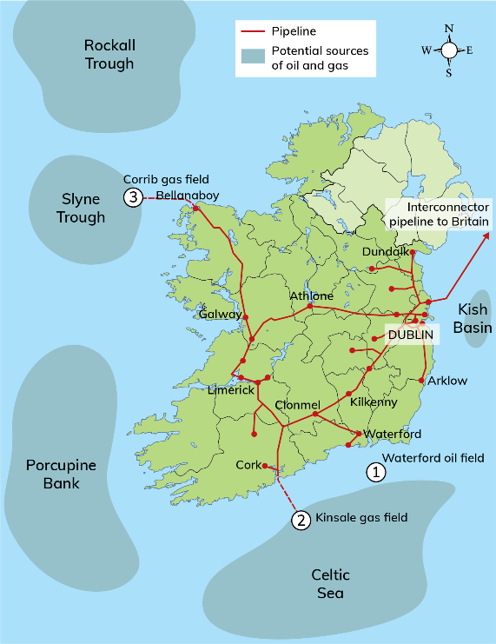
6.2 Describe and explain the environmental, economic and social consequences of exploiting energy resources.
Corrib gas field
Discovered in 1996
Will supply 60 per cent of Ireland’s gas needs for up to 20 years
Processing terminal in Bellanaboy
Local protest group called ‘Shell to Sea’ opposed the pipeline
Ireland
Kinsale Head gas field
Discovered in 1971
Gas piped ashore and distributed
Gas sold to Bord Gáis Energy
Exhausted in 2020
Waterford oil field
A small oil deposit
Too expensive to drill

Slide 34
6.2 Describe and explain the environmental, economic and social consequences of exploiting energy resources.
Ireland
Environmental impacts | Economic impacts | Social impacts
Oil and gas exploitation contributes to climate change. Nature is disturbed by digging pipelines and constructing refineries. | Jobs are created from digging pipelines and from refining and distributing the resource. Indirect jobs are also created, as a result of increased income locally. | There is growth of infrastructure and settlement. There may be conflict over how the resource is exploited.

Slide 35
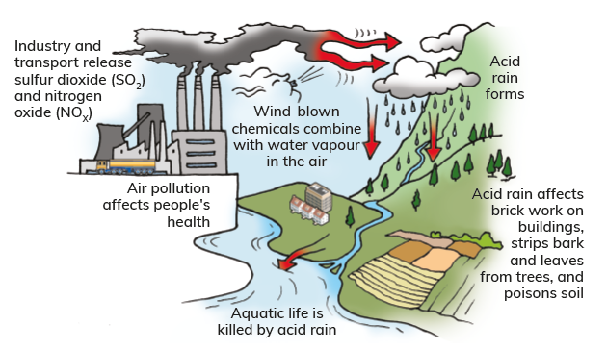
6.3 Explain the need to use energy resources sustainably.
Causes of acid rain
1. Industry and transport emit sulfur dioxide (SO₂) and nitrogen oxides (NO_{x}) into the atmosphere.
2. These gases mix with water vapour and form acid rain.
3. This mixture falls as acid rain.
4. Prevailing winds can carry pollutants vast distances, causing acid rain to fall far from its source.
5. This means that areas that do not burn fossil fuels can be affected by pollutants blown from areas that do.

Slide 36
6.3 Explain the need to use energy resources sustainably.
Effects of acid rain
1. Freshwaters
Acid rain damages fish life and plants.
In Scandinavia, thousands of lakes are known as ‘dead lakes’.
2. Soils
Acid rain makes soils more acidic.
This causes leaching.
Soils become infertile.
3. Buildings
Acid rain damages buildings, especially those made of limestone and marble.
This affects tourism, as historic buildings are primary tourist attractions.
4. Forests
Acid rain stunts the growth of trees.
Leaves become discoloured and can drop off.

Slide 37
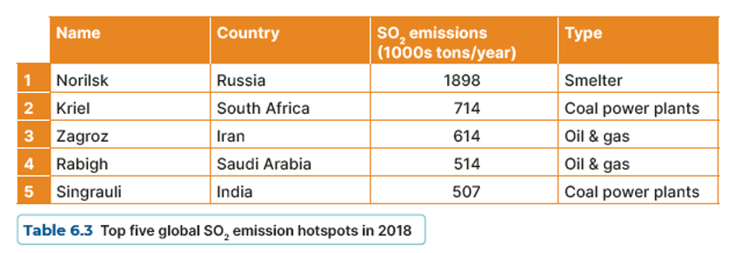
6.3 Explain the need to use energy resources sustainably.
Activity
Sulfur dioxide (SO₂) is one of the major emissions responsible for acid rain. Examine the table below and answer the questions that follow.
1. Which location is the largest single source of SO₂?
2. What is a smelter?
3. How much SO₂ is released by the top five SO₂ hotspots combined?
4. Of the top five sources of sulfur dioxide, how many of them use fossil fuels?
5. List three effects of SO₂ emissions.

Slide 38
6.3 Explain the need to use energy resources sustainably.
Solutions to acid rain
Using public transport reduces the levels of emissions that cause acid rain. Using electric cars and trucks would reduce acid rain even more.
Using renewable energy sources such as solar power and wind turbines reduces the pollutants that cause acid rain.
Reducing the amount of energy used to heat homes and industry can help reduce acid rain.

Slide 39

6.3 Explain the need to use energy resources sustainably.
1. What are hydrocarbons?
2. Name three places in Ireland where hydrocarbons were discovered.
3. What causes acid rain?
4. List four effects of acid rain on the environment.
5. Suggest one way people can help reduce acid rain.

Slide 40
6.3 Explain the need to use energy resources sustainably.
Higher-order questions 4
1. Is there geothermal energy in Ireland?
2. How does geothermal energy help limit climate change?
3. Why do some people continue to live near volcanoes?

Slide 41
6.3 Explain the need to use energy resources sustainably.
Go to Section 6.3 on page 24 of your Skills Book.

Slide 42
Assess your progress
Go to page 25 of your Skills Book and assess your progress.
6.1 Describe the different renewable and non-renewable energy resources.
6.2 Describe and explain the environmental, economic and social consequences of exploiting energy resources.
6.3 Explain the need to use energy resources sustainably.
Identify any gaps in your learning. Use the Rapid Revision on page 69 of your Textbook to jog your memory.

